Slide 1


CropSentry
Research
Presentation

Slide 2
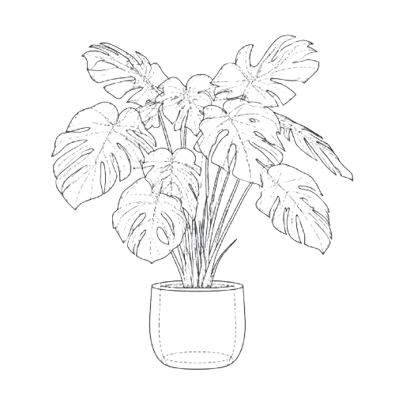


The Problem
Industry Concerns
$220B
Over $60B is spent annually on crop protection applied on a calendar schedule or after symptoms appear, not when stress begins.
Lost from plant disease
20-40%
Globally lost plants due to diseases
63M+ tons
Lost crops in America from the past 4 years

Slide 3
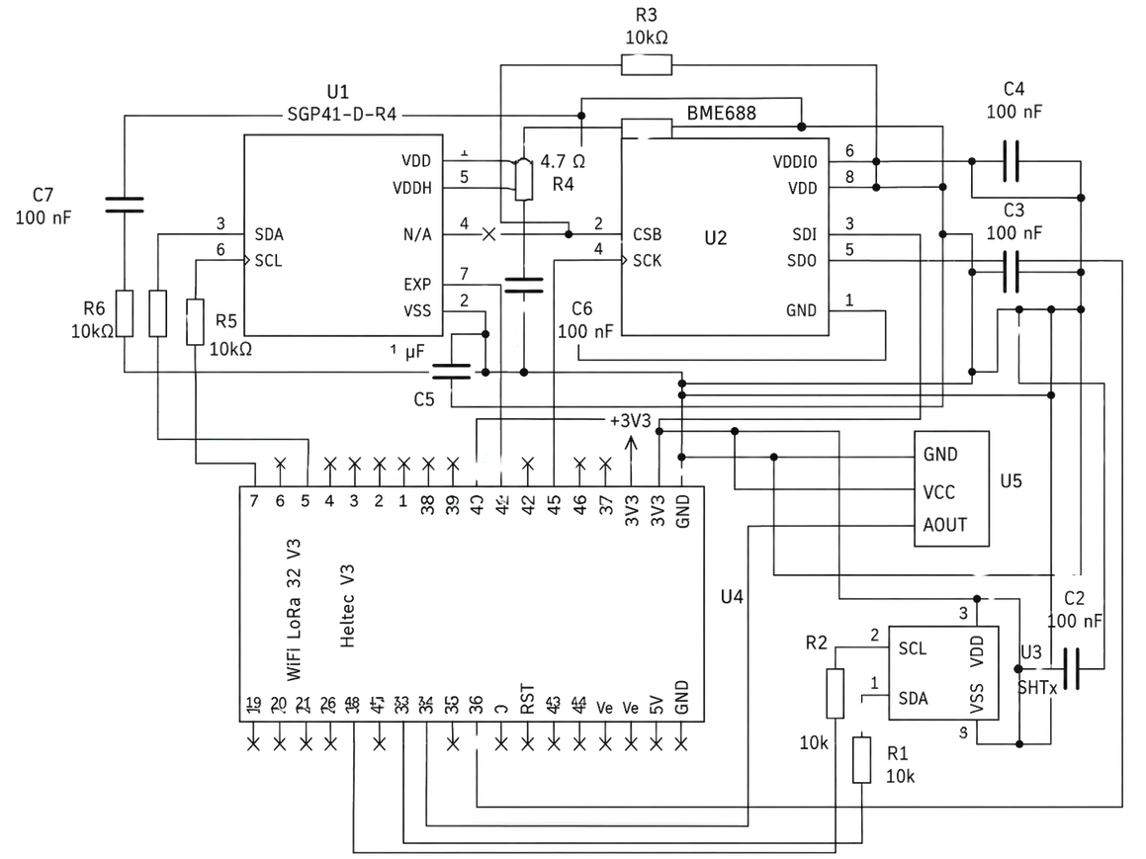
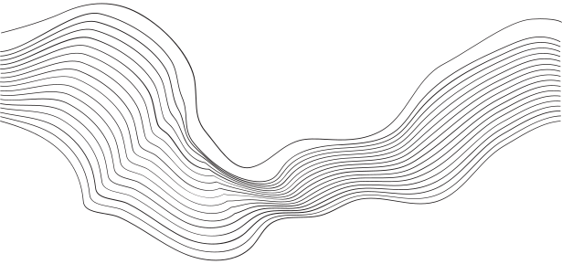
The Solution
Logic
VOC (Volatile Organic Compound) sensors read the air that a plant emits. A temperature and humidity sensor provides the ambient baseline, isolating the plant's signal from the environment's.
Using solar power to charge the module, CropSentry is able to run fully autonomously and without excessive maintenance.
About the Project
CropSentry reads the compounds a plant emits, plus soil and ambient conditions, to catch stress before symptoms show. Nodes report to a gateway to your phone.

Slide 4

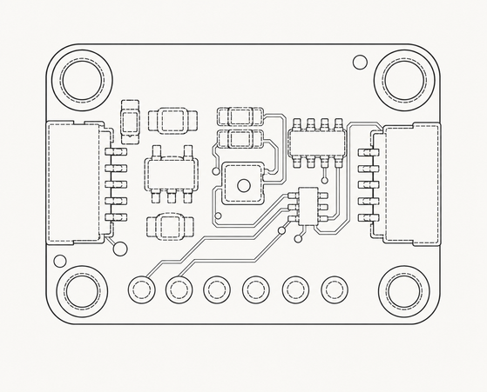
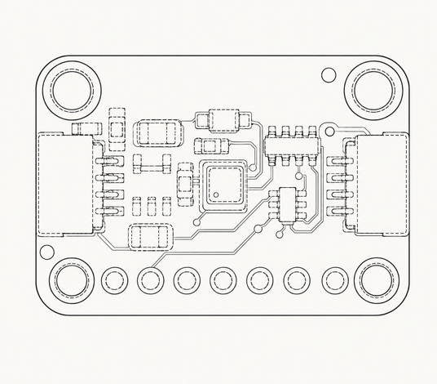
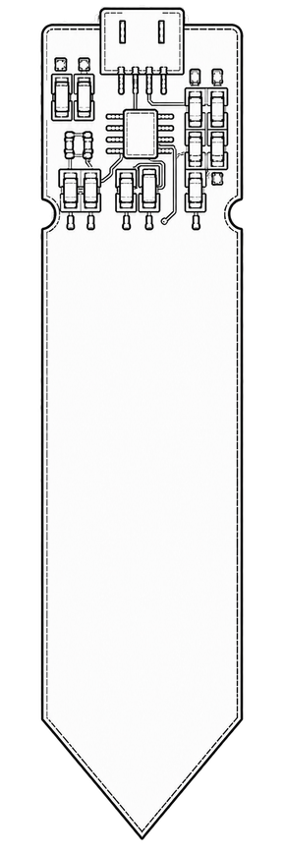
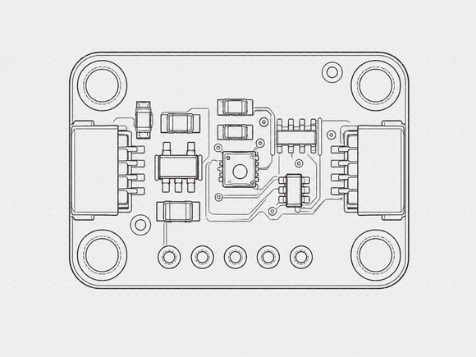
Hardware
BME688
SHT45
Checks for VOCs, temperature, humidity, and pressure
Secondary temperature and humidity sensor as an ambient system
Soil Moisture Probe
SGP41
Detects when water in the soil is insufficient and sends an alert to the user for watering
Secondary VOC detection system to ensure accurate readings

Slide 5


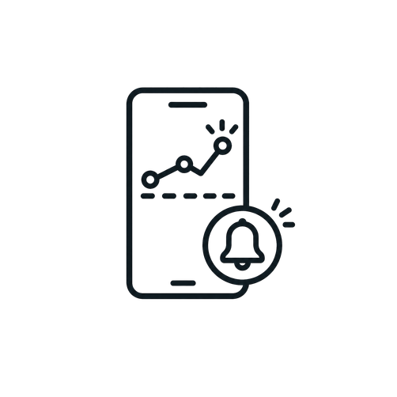
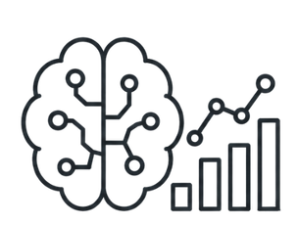
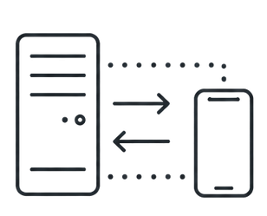
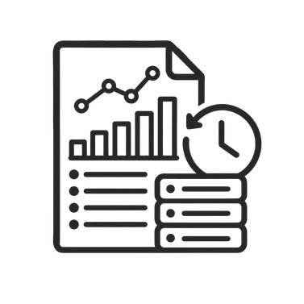

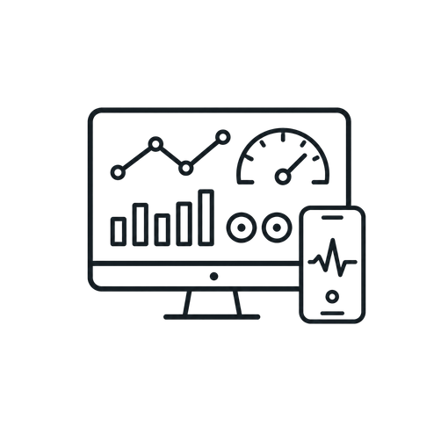
Software
01
02
03
04
05
06
Data Logging
RT Dashboard
History and Logs
IO streams connecting data from server to app continuously
Live visual display of active sensor readings
Stored records and charts to track long-term performance
Authentication
ML Analysis
Push Notifications
Secure account creation, login, and profile management
ML models that evaluate incoming data
Instant threshold-based alerts sent to devices
Notes:
1. Creating and storing user data for secure access to their farm data. This is done using Firebase Auth.
2. IO streams that connect to the server and app creating constant data streaming.
3. A machine learning model that is able to learn and detect when and what disease is in the field
4. Real time dashboard showing all the sentries
5. Push Notifications that the user can enable and receive immediately.
6. Graphs

Slide 6
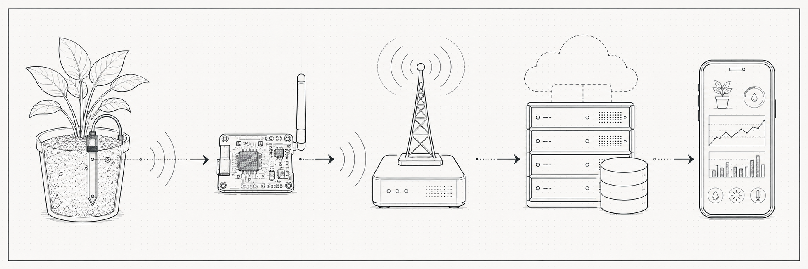
System Architecture
Vision
To use multiple methods of data transfer to ensure range while also providing accurate readings to the user
I
II
III
IV
IV
Starts by collecting 56 data samples and sending one collection of info via radio signal
Takes radio signal and processes data through WiFi to be received through a server
Server processes information and sends details to the user’s device through the app
The app translates data and provides user-readable information about their plants
The user can virtually interact with their plant and get a full diagnosis regarding diseases and health

Slide 7


Potential
Continuous monitoring replaces manual scouting.
Detects stress before symptoms are visible.
One gateway serves many nodes across a field.
Runs unattended on solar for a full season.

Slide 8
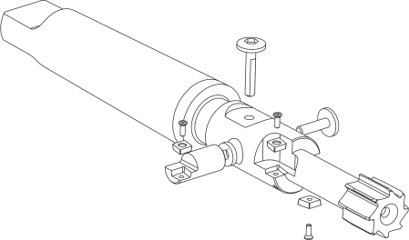
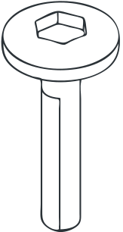

Q/A
Thank you for being a part of this presentation! Any questions are appreciated.

Slide 9
References
Betts, A. K., Sisson, A. J., Ahumada, D. H., Allen, T. W., Anderson, N. R., Bergstrom, G. C., Bish, M., Bissonnette, K. M., Broderick, K. C., Byamukama, E., Chilvers, M. I., Collins, A. A., Duffeck, M. R., Esker, P. D., Faske, T. R., Friskop, A. J., Harbach, C., Heiniger, R. W., Isakeit, T., … Zeng, Y. (2026). Corn yield loss estimates due to diseases in the United States and Ontario, Canada, from 2020 to 2023. Plant Health Progress, 27(2), 257–268.
Food and Agriculture Organization of the United Nations. (2019, March 4). New standards to curb the global spread of plant pests and diseases.
Food and Agriculture Organization of the United Nations. (2026, July 21). The hidden health crisis: How plant diseases threaten global food security.

